Slide 1
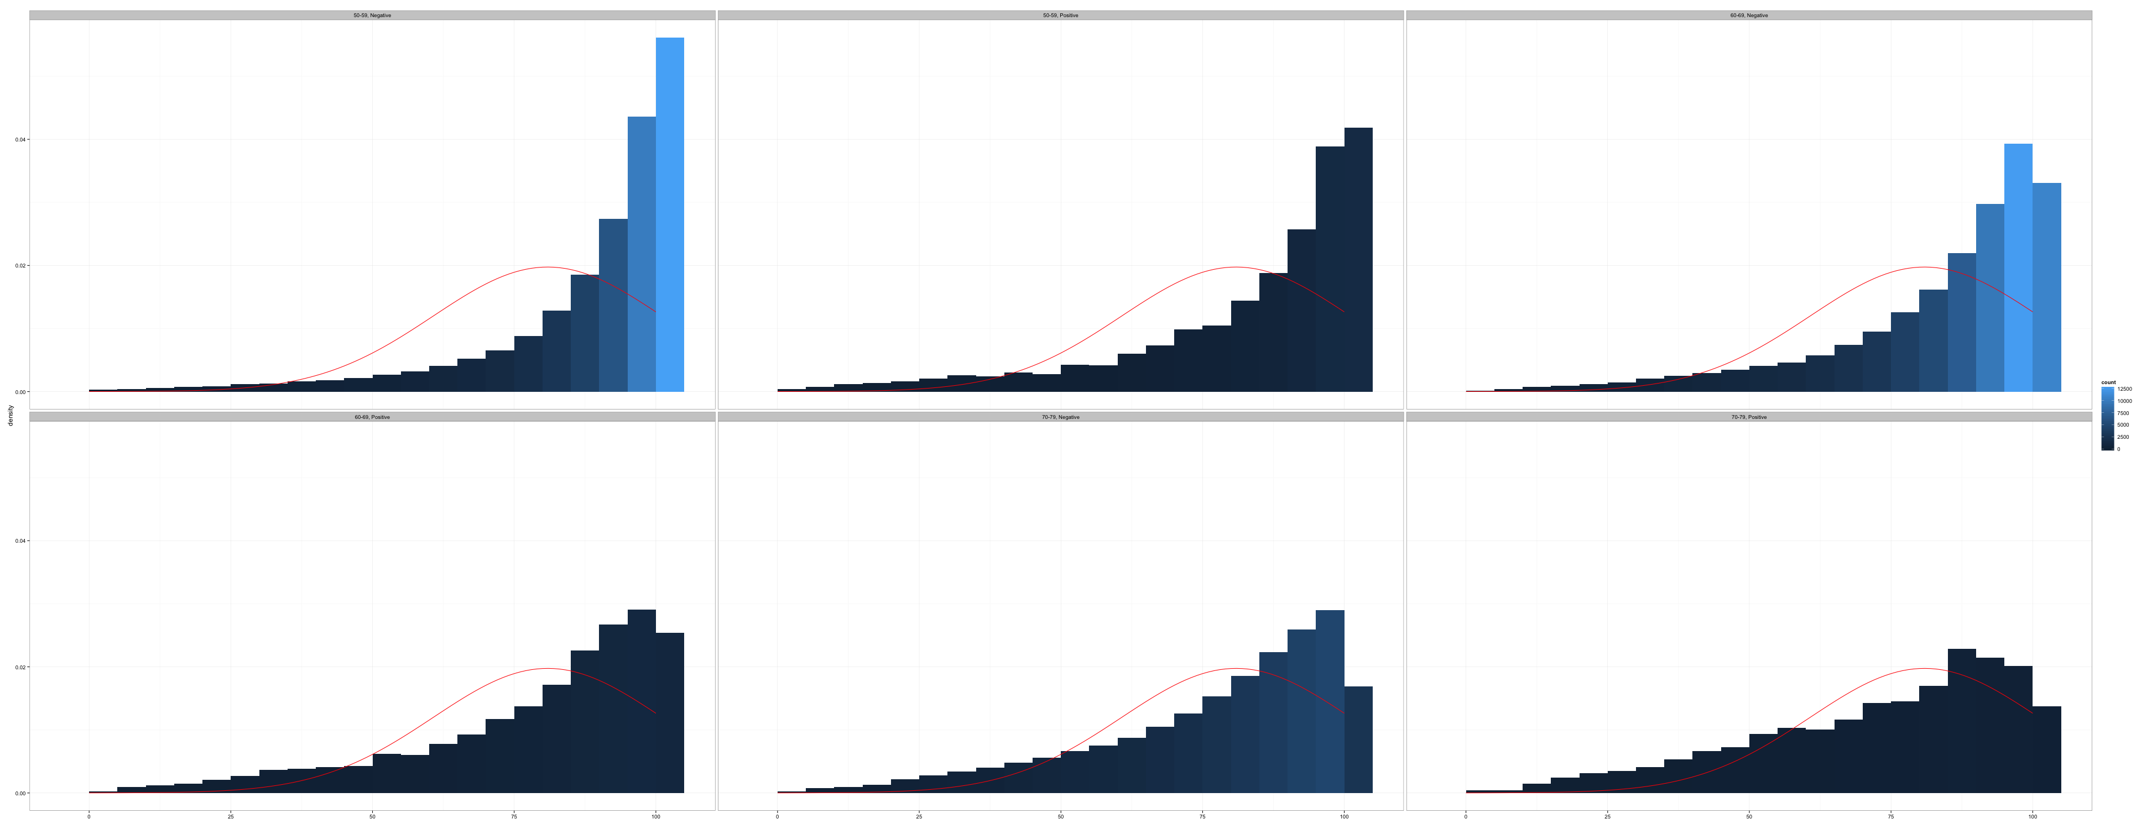
Introduction to Skip Patterns
Introduction to Data Management and Statistical Computing
Notes:
In this video we’re going to discuss skip patterns in surveys. We’ll begin with a brief overview of what skip patterns are.

Slide 2
Question 1
Question 2
Question 3
Notes:
In some surveys, every participant is asked every question, one after another, in a linear sequence.

Slide 3
No
Question 1
Question 2
Question 3
Yes
Notes:
When a survey has skip patterns, then every participant does not necessarily answer every question. The next question a given participant is asked depends on the answer they gave to the current question. In some circumstances, questions will be skipped entirely. In the graphic displayed here, if the participant answered “no” to question 1, then the next question they are asked is question 3 – skipping question 2 entirely.

Slide 4
Why would you skip questions?
Notes:
But, why would you ever want to do that?

Slide 5
Why would you skip questions?
Reduce participant burden
Increase efficiency
Notes:
Well, in general, the decision to include skip patterns would be made in order to reduce the burden to your participants, and to increase the efficiency in administering your survey. Next, I’ll show you some concrete examples to try to clarify what I mean.

Slide 6

Notes:
Let’s suppose you have a survey that includes a series of questions related to cancer.

Slide 7
In what year were you first told that you have cancer?
In what month were you first told that you have cancer?
Notes:
You might want to ask people when they were diagnosed with cancer. These two questions would be a reasonable place to start.

Slide 8
Which of the following forms of cancer were you told you have?
Notes:
You may also want to ask them about the type of cancer they were diagnosed with.

Slide 9
Which of the following forms of treatment did you receive for cancer?
Notes:
Or, you might ask them about the treatment they received.

Slide 10
In what year were you first told that you have cancer?
In what month were you first told that you have cancer?
Which of the following forms of treatment did you receive for cancer?
Which of the following forms of treatment did you receive for cancer?
Notes:
All of these would be reasonable questions unless, of course, you’ve never had cancer. If you’ve never had cancer, you may find it confusing to be asked these questions, difficult to respond to these questions, and you may even feel as though your time is being wasted.

Slide 11
Have you ever been told that you have cancer?
In what year were you first told that you have cancer?
In what month were you first told that you have cancer?
Which of the following forms of cancer were you told you have?
Which of the following forms of treatment did you receive for cancer?
Notes:
One way to address these problems is to first ask your participants if they’ve ever had cancer.
Sometimes, you may hear this referred to as a parent question. And, all the other cancer related questions that follow may be referred to as child questions. Please do not confuse this with questions about childhood cancer. That isn’t what we’re talking about here.

Slide 12
Have you ever been told that you have cancer?
Have you ever been told you have asthma?
Yes
In what year were you first told that you have cancer?
In what month were you first told that you have cancer?
Which of the following forms of cancer were you told you have?
Which of the following forms of treatment did you receive for cancer?
Notes:
So, if the participant answers “yes” to the parent question, then you proceed through the rest of your child questions linearly, one after another.

Slide 13
No
Have you ever been told that you have cancer?
Have you ever been told you have asthma?
In what year were you first told that you have cancer?
In what month were you first told that you have cancer?
Which of the following forms of cancer were you told you have?
Which of the following forms of treatment did you receive for cancer?
Notes:
But, if they say no to the parent question you skip over the related child questions, and ask the next relevant question.
By not asking your participant irrelevant questions, you are decreasing the burden they experience by participating in your survey. Additionally, this makes it possible for you and your survey staff to more efficiently get through the surveys.

